Slide 1

Design and implementation of the IoT in-home display
Internet of Things (IoT)
Project Presentation
Supervisor: Assoc. Prof. Dr. Chaiyod Pirak
Muhammad Ashhab Khan
Sana Khurram
Muhammad Hamza Zafar
Team Members

Slide 2

Presentation Content
Introduction
Conceptual Design
Hardware Components
Software flowchart
Demo Video
Task Distribution
Challenges
Questions

Slide 3
Introduction
A user-friendly GUI on mobile application for kWh consumption logging
Predict monthly energy consumption through algorithm
Estimated bill prediction during the month
High bill alert notification on mobile application
Online energy consumption and bill monitoring through internet

Slide 4

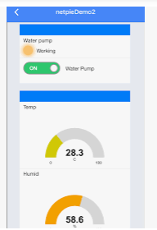
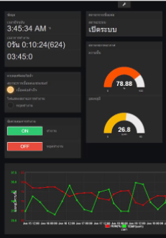
Conceptual Design
LCD
I2C
Voltage Sensor
MUX
(CD74HC4067)
ESP8266 (with built-in RTC)
Current Sensor
Mobile App
(Push Notification)
Dashboard

Slide 5
Hardware Components
1. AX-WiFi with OLED board -> Main controller board with ESP8266
2. MUX (CD74HC4067) -> Voltage and current sensor
3. ZMPT101B -> AC voltage sensor (1000 V)
4. ACS712 -> AC current sensor (-30A to + 30A)
5. Power Resistors (10 Ohm)

Slide 6
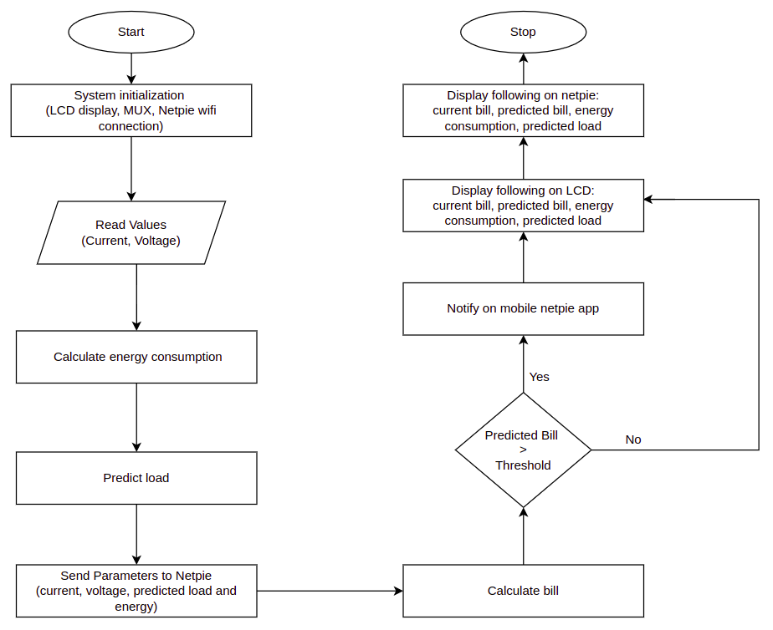
Software Flow Chart

Slide 7
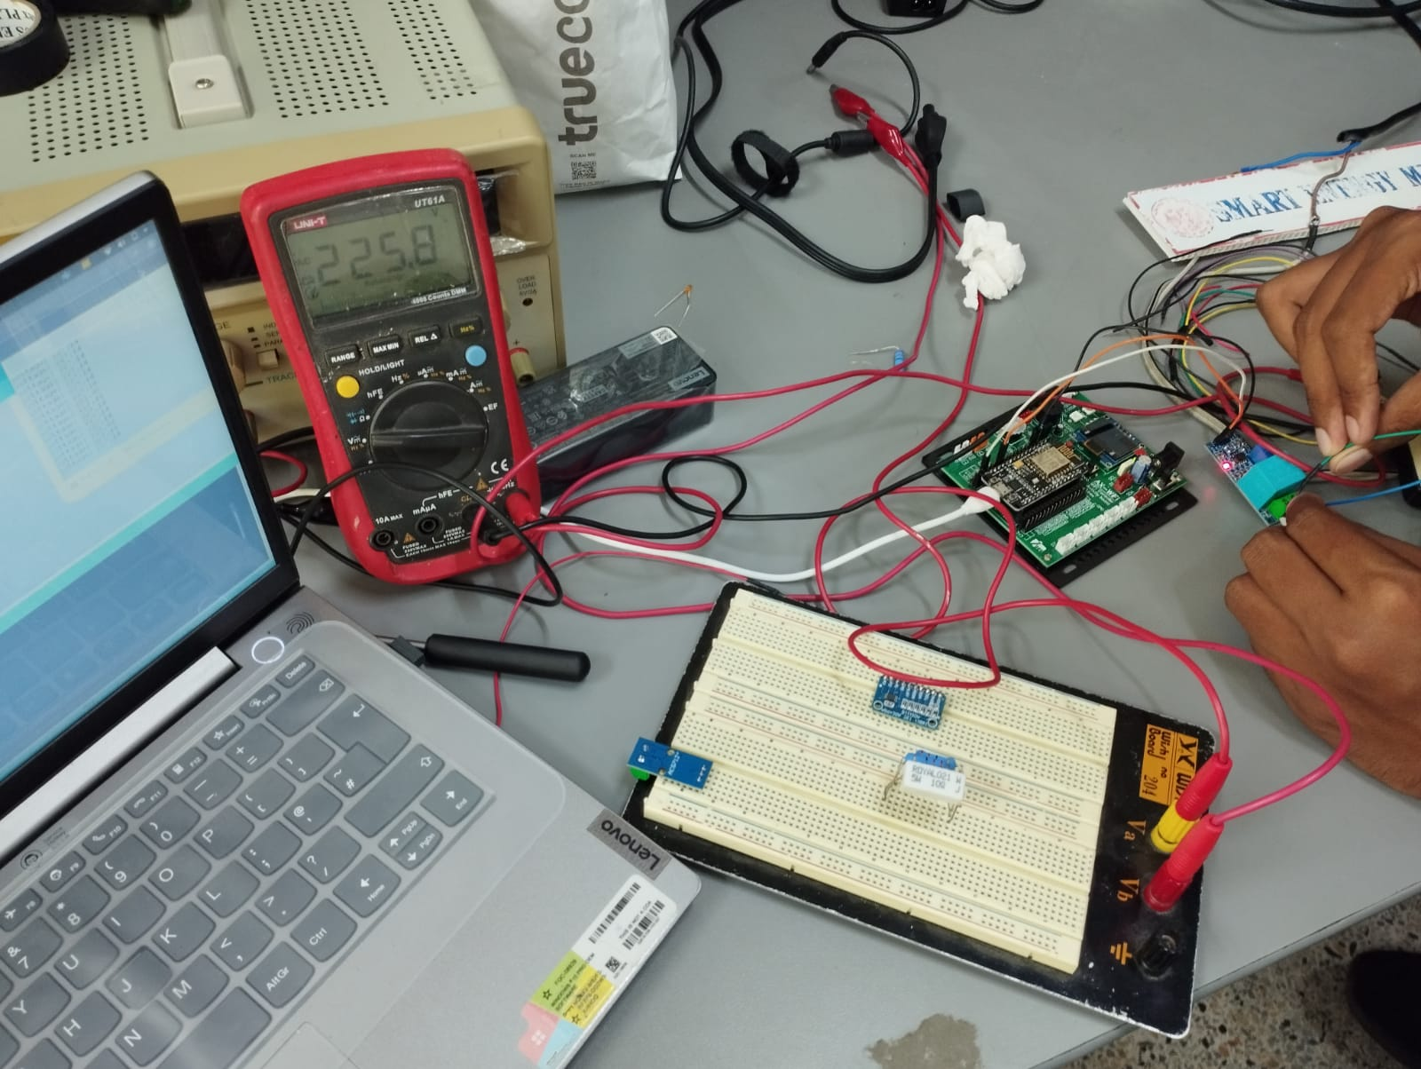
Demo - Voltage Sensor Testing

Slide 8
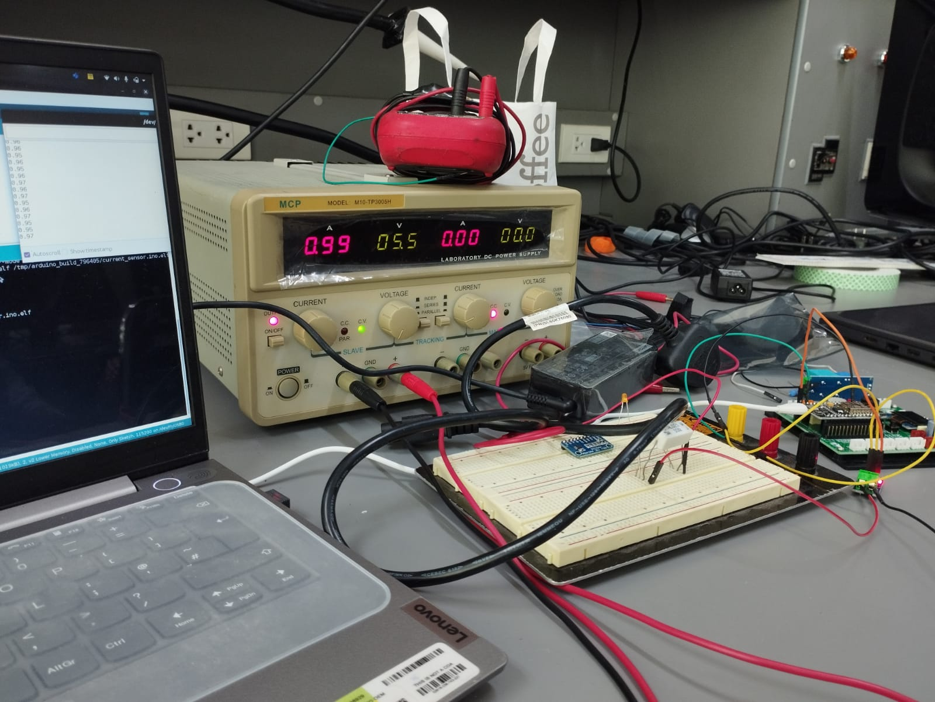
Demo - Current Sensor Testing

Slide 9
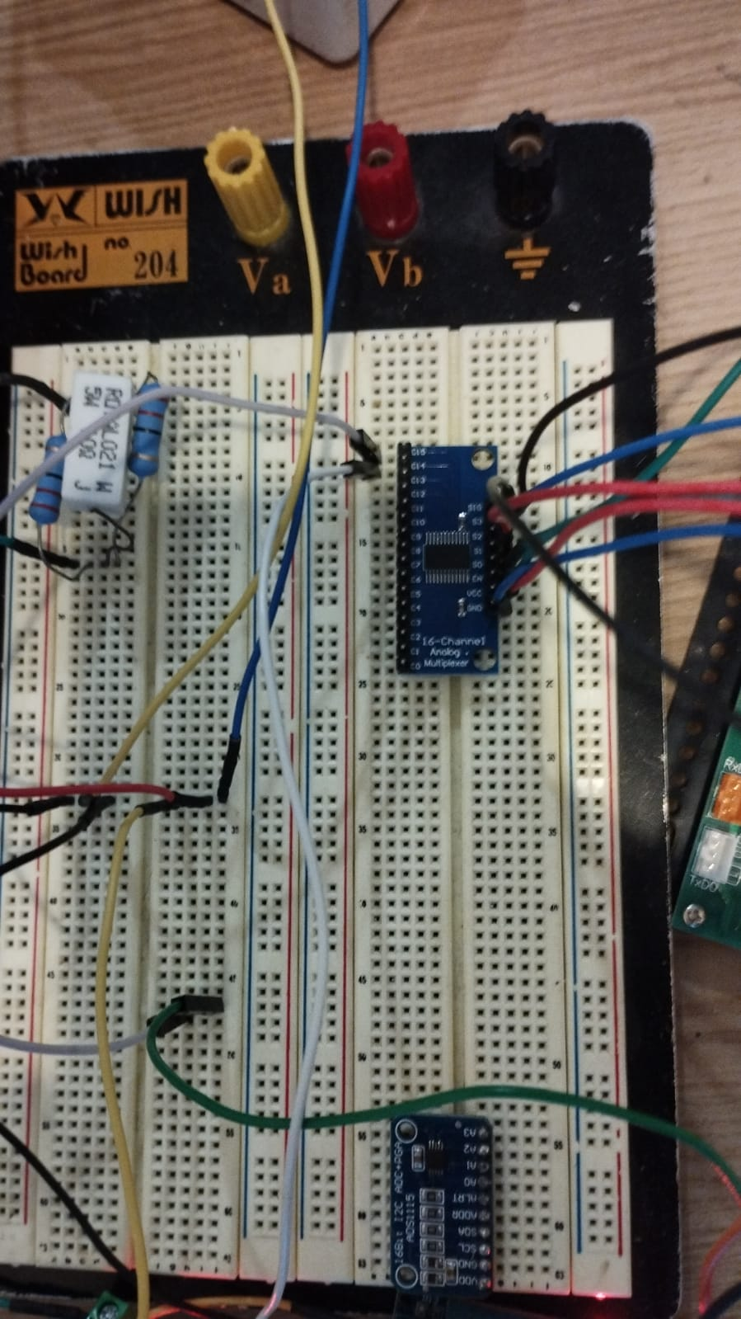
Demo - MUX Testing

Slide 10
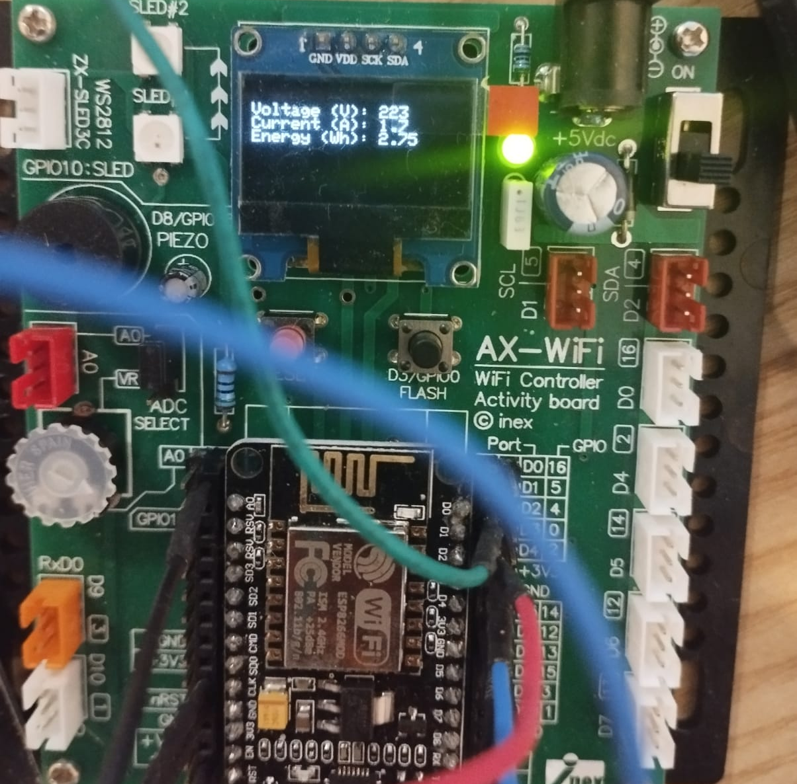
Demo – LED Testing

Slide 11
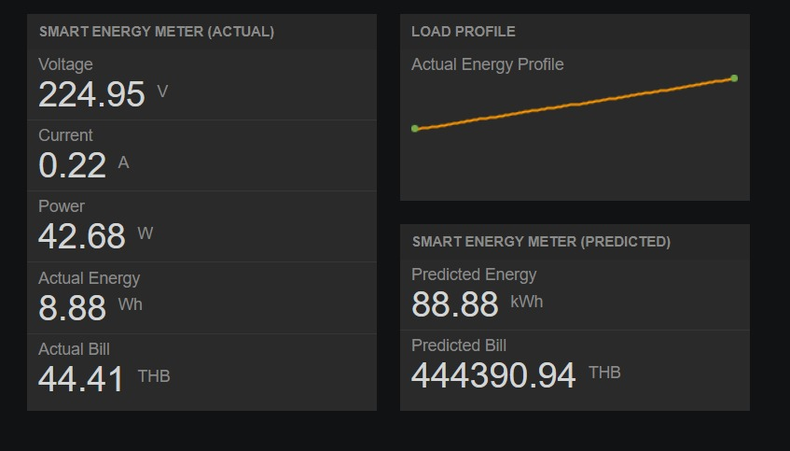
Demo - NETPIE Implementation

Slide 12
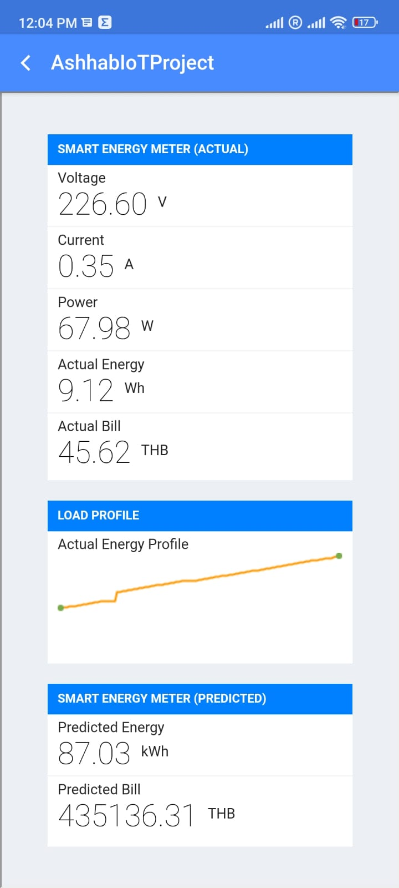
Demo - NETPIE Mobile Implementation

Slide 13
Demo - Video

Slide 14
Task Distribution
[HW A1.1] ADS1115 (ADC) Communication with ESP8266
[HW B1.1] ZMPT101B (Voltage Sensor) Communication with ESP8266
[HW C1.1] ACS712 (Current Sensor) Communication with ESP8266
[HW A1.2] Read both voltage and current sensor through ADC in ESP8266
[HW D1.1] LCD display/operate with ESP8266
[SW A1.1] Load prediction and Energy Consumption Algorithm
[SW B1.1] Implementation(code) of load prediction and energy consumption on Hardware
[SW C1.1] NetPie platform GUI for dashboard and mobile application

Slide 15
Task Distribution
Team Member | Task
Muhammad Ashhab Khan | HW D1.1 SW A1.1, SW B1.1, SW C1.1
Sana Khurram | HW A1.1, HW A1.2 SW B1.1, SW C1.1
Muhammad Hamza Zafar | HW B1.1, HW C1.1 SW A1.1, SW B1.1
GitHub Repository Link: https://github.com/ashhabkhan/IoT_in_home_display

Slide 16
Challenges and Improvements
ADS 1115 Calibration Issue
PCB Design
EPROM storage
Collection of Data and use ML approaches

Slide 17
THANK YOU! Questions?

